Slide 1
Predicting Penetration in Diffusion Case Based On One Oscillation Near the Bifurcation Point in the Zero Diffusion Case
By Michelle Goodman
31/Jan/2017

Slide 2
Based on the Homogenisation paper:
Three criteria must occur for penetration of oscillations past the bifurcation point
Asymmetric wave concentration profile in time
The frequency of oscillations is a function of the hopf bifurcation parameter, β
There is a spatial variation of β

Slide 3
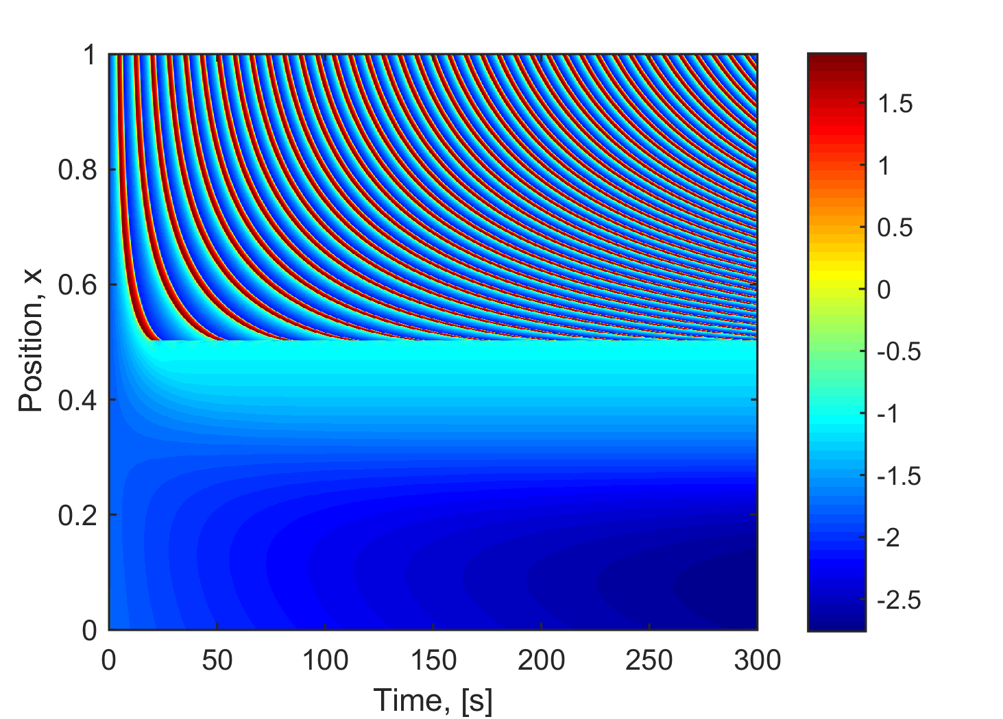
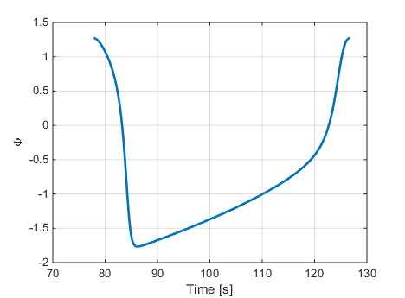
Given one oscillation near the bifurcation point
(Peak to peak)
Zero Diffusion Case Toy Model

Slide 4
Question: Can you decide, based on this alone, if and when the model will penetrate the oscillations past the bifurcation point?

Slide 5

Assumptions
The profile does not change in small changes in the x direction
Profile(X_{B}+ε) $≅$ Profile(X_{B}) where X_{B} = Bifurcation Point
For small change in x/beta the change in the length of the period skew of the profile is negligible

Slide 6
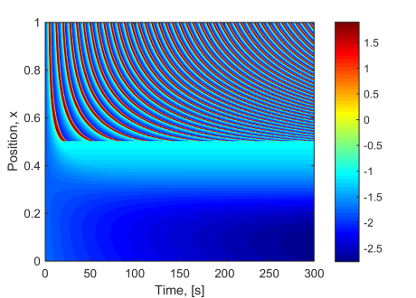

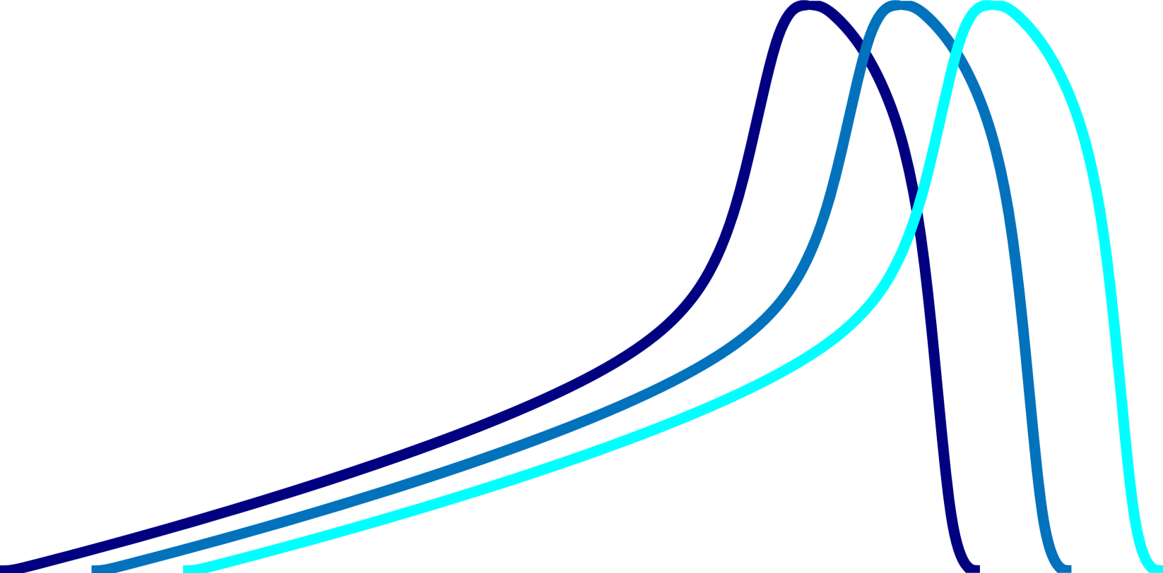

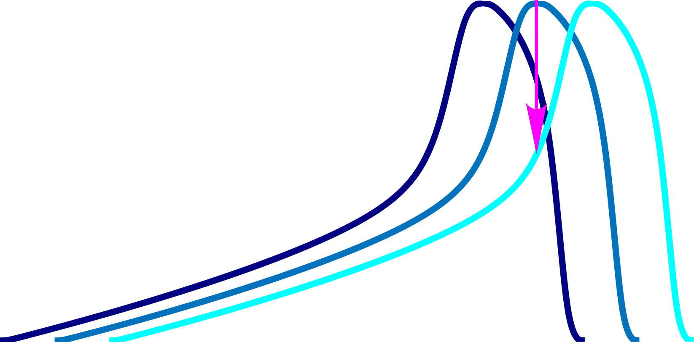
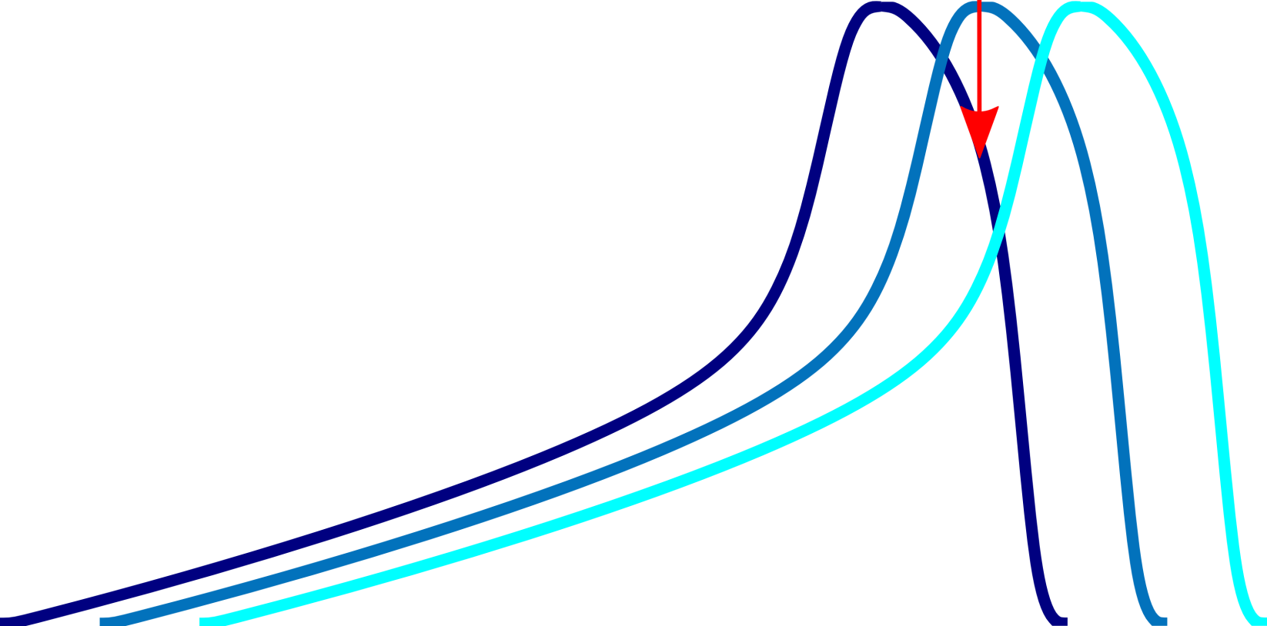

Visualisation
Dark Blue is ‘above’
With a smaller period
With a larger beta
Further away from the bifurcation pt
Light Blue is ‘below’
With a larger period
With a smaller beta
Closer to the bifurcation pt
To ‘Above’
To ‘Below’
Net is to ‘Below’

Slide 7
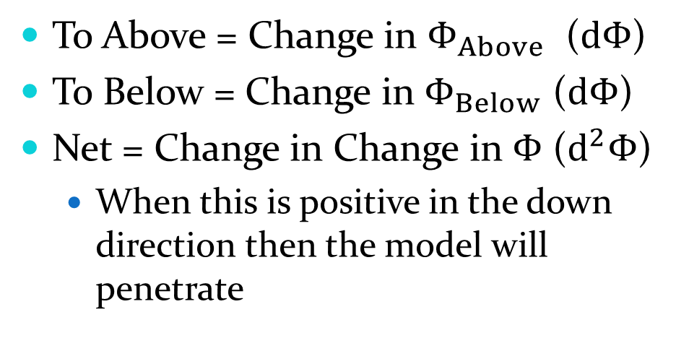
What are we finding?
To ‘Above’
To Above = Change in $Φ_{Above}$ ($dΦ$)
To Below = Change in $Φ_{Below}$ ($dΦ$)
Net = Change in Change in $Φ$ ($d^{2}Φ$)
When this is positive in the down direction then the model will penetrate
To ‘Below’
Net is to ‘Below’

Slide 8
Beats
Finally we need to remember that we are dealing with two different periods therefore the oscillations will become in and out of phase overtime creating beats
A 5 second phase lag on oscillation one will mean
A 50 second phase lag on oscillation ten
for a 50 second period that’s one whole period

Slide 9
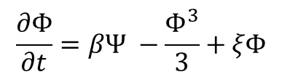
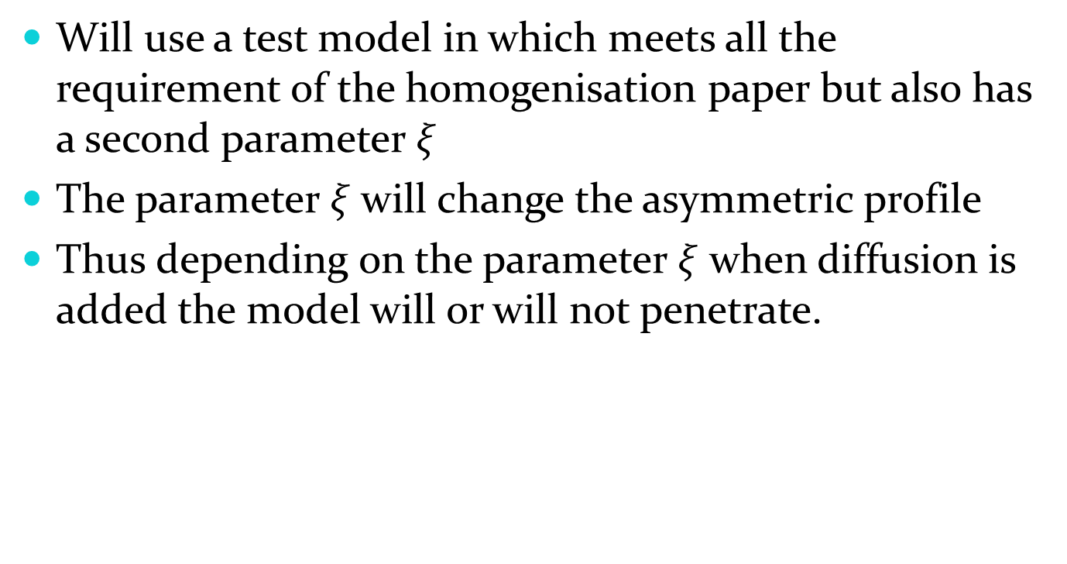

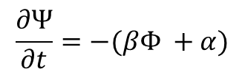
To Test
Will use a test model in which meets all the requirement of the homogenisation paper but also has a second parameter $ξ$
The parameter $ξ$ will change the asymmetric profile
Thus depending on the parameter $ξ$ when diffusion is added the model will or will not penetrate.
$$\frac{∂Φ}{∂t}=βΨ −\frac{Φ^{3}}{3}+ξΦ$$
$$+ D\frac{∂^{2}Φ}{∂x^{2}}$$
$$\frac{∂Ψ}{∂t}=−(βΦ +α)$$

Slide 10
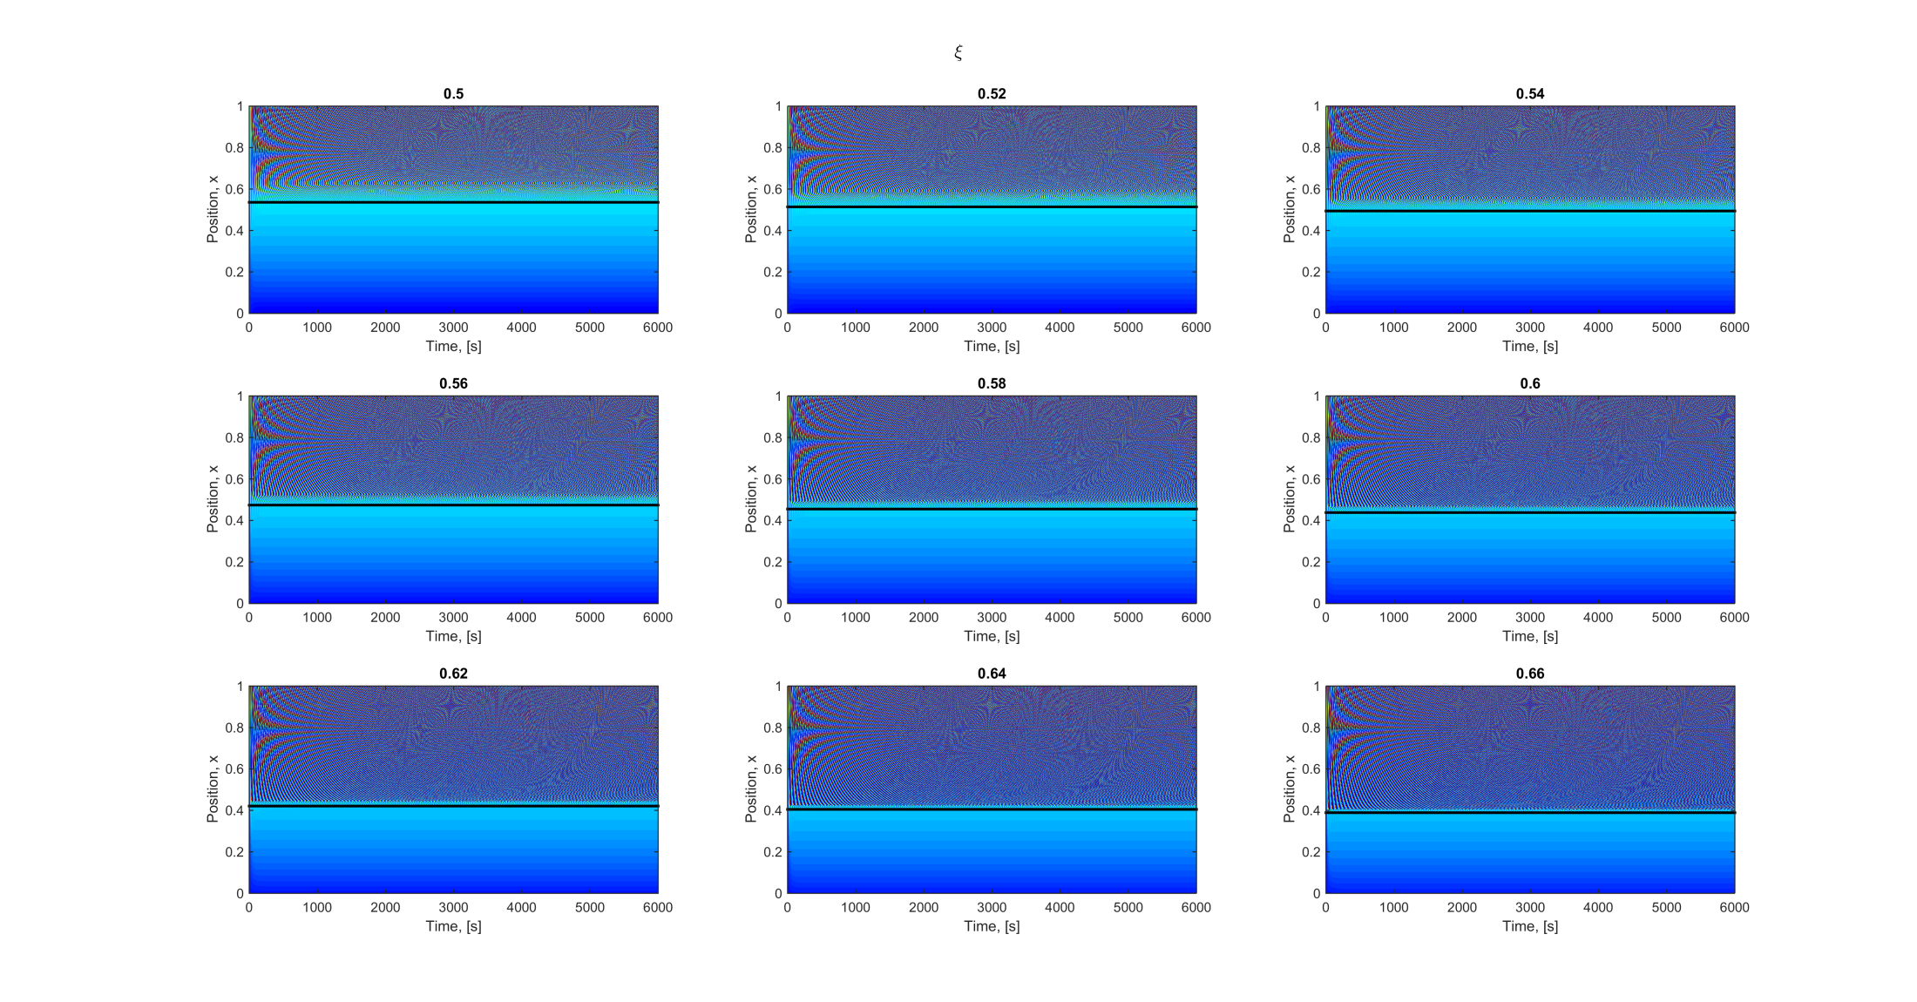
Zero Diffusion

Slide 11
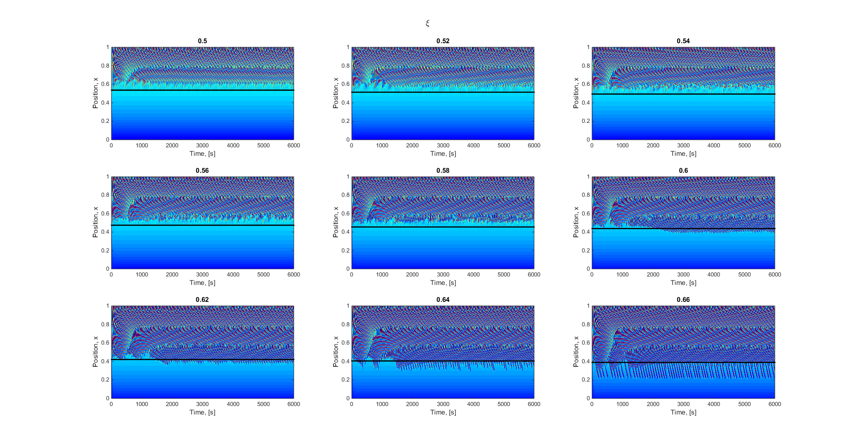
Diffusion Case

Slide 12


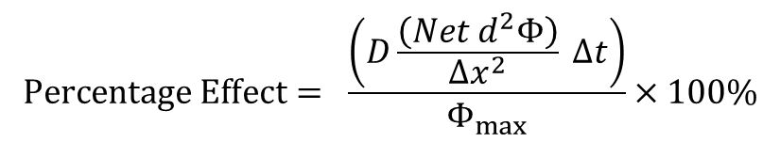
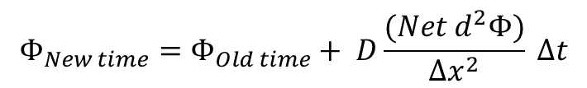
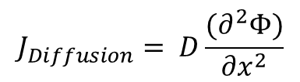
For each $ξ$ look at its first wave
For different phase lags (percentage of period) find:
To Above = Change in $Φ_{Above}$ ($dΦ$)
To Below = Change in $Φ_{Below}$ ($dΦ$)
Net = Change in Change in $Φ$ ($d^{2}Φ$)
Next find the $Φ$ ‘concentration’ due to diffusion
$$J_{Diffusion}= D\frac{(∂^{2}Φ)}{∂x^{2}}$$
$$Φ_{New time}=Φ_{Old time}+ D\frac{(Net d^{2}Φ)}{Δx^{2}} Δt$$
> Tol of change and error
then it will penetrate
$$Percentage Effect= \frac{\left(D\frac{\left(Net d^{2}Φ\right)}{Δx^{2}} Δt\right)}{Φ_{max}}×100\%$$

Slide 13
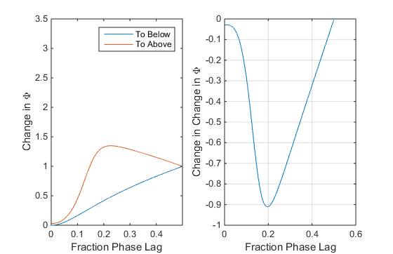
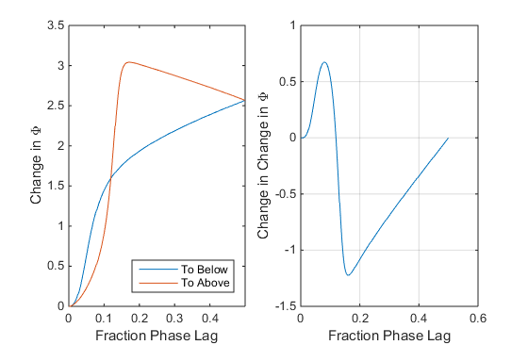
Look at two examples
Doesn’t Penetrate | Does Penetrate

Slide 14
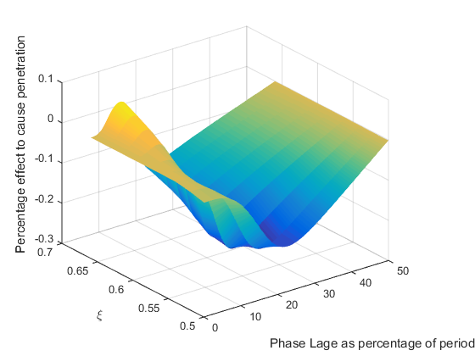
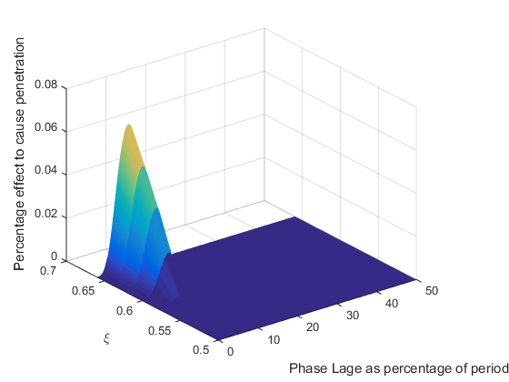
End Up With a Grid

Slide 15
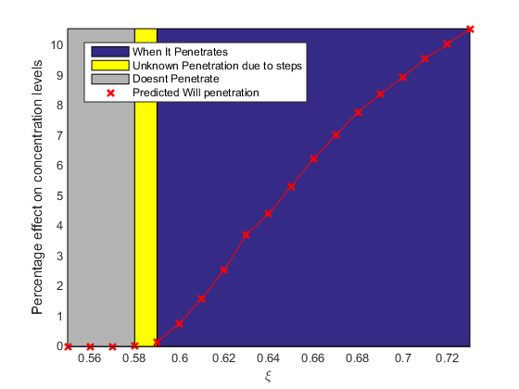
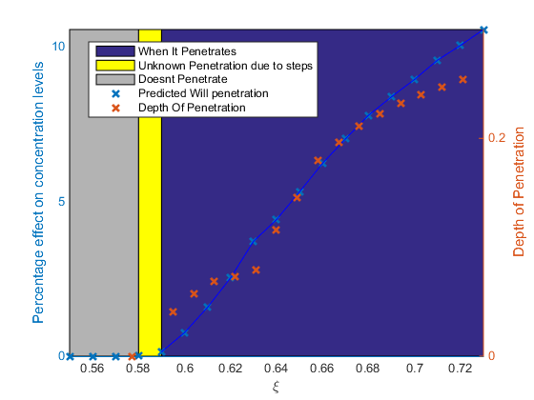
Maximum Percentage Effect

Slide 16
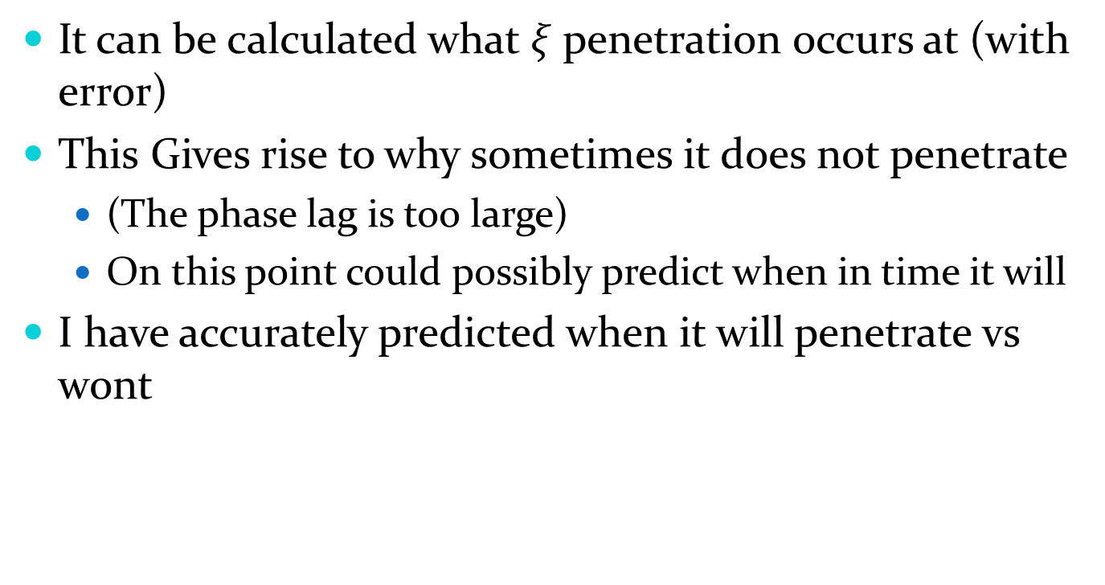
Conclusion
It can be calculated what $ξ$ penetration occurs at (with error)
This Gives rise to why sometimes it does not penetrate
(The phase lag is too large)
On this point could possibly predict when in time it will
I have accurately predicted when it will penetrate vs wont

Slide 17
Next Step:
Compute the following models to compare and confirm
Goldbeter
Ernmentrout
Other Toy Models

Slide 18
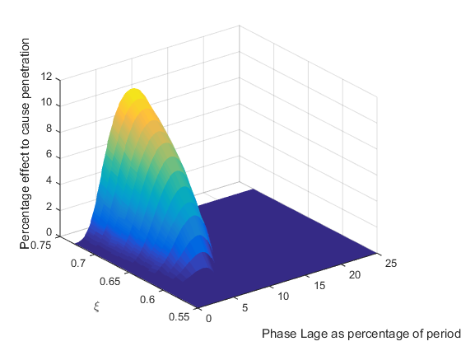
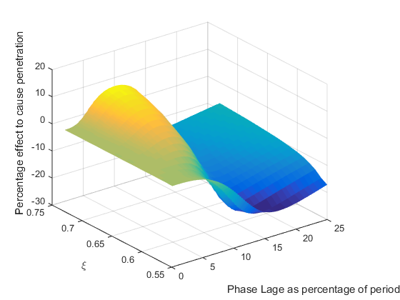
(More Detail)

